Slide 1
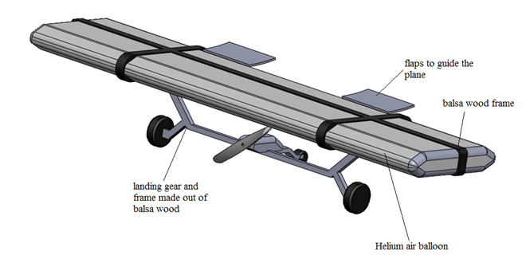
VIT Sounding Rocket
Team
Cross over between an Air Ship
and a R C Plane

Slide 2

Blimp
Airships are called lighter-than-air (LTA) craft because to generate lift, they use gases that are lighter than air. The most common gas in use today is helium
Because gas provides the lift in an airship or blimp, rather than a wing with an engine as in an airplane, airships can fly and hover without expending fuel or energy. Furthermore, airships can stay aloft anywhere from hours to days, much longer than airplanes or helicopters.

Slide 3
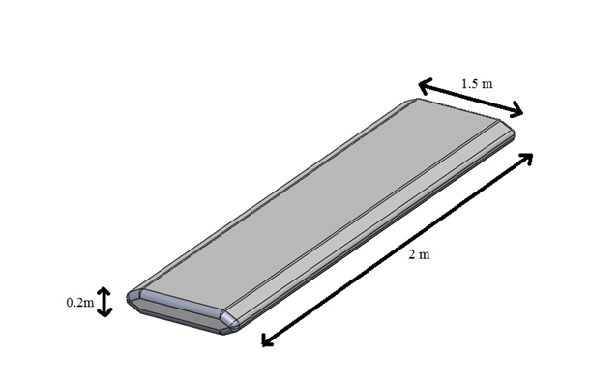
Concept
The Lighter than air gas filled in the envelope generates a upward force. So theoretically If we attach an object which has a weight equal to the upward thrust both nullify each other. Creating a body which experiences zero force due to gravity.
Now if the object we are attaching is able to generate thrust such as a propeller. Then we should be able to maneuver the blimp in air.
But according this concept it does not define how the shape of the envelope should be. It practically works in any shape as long as it generates enough amount of thrust in the upward direction.
So the design was to come up with a shape like a wing of a plane. Which is an aerofoil. According to aerofoil theory if the structure move in the horizontal direction a upward life is generated. Due to pressure difference.

Slide 4
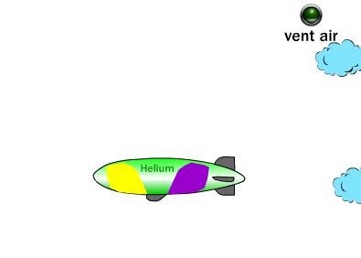
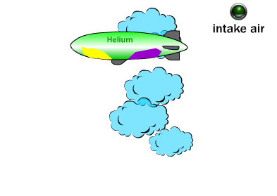
Maneuverability
A blimp or airship controls its buoyancy in the air. The ballonets act like ballast tanks holding "heavy" air. When the blimp takes off, the pilot vents air from the ballonets through the air valves. The helium makes the blimp positively buoyant in the surrounding air, so the blimp rises.
As the blimp rises, outside air pressure decreases and the helium in the envelope expands. The pilots then pump air into the ballonets to maintain pressure against the helium. Adding air makes the blimp heavier, so to maintain a steady cruising altitude, the pilots must balance the air-pressure with the helium-pressure to create neutral buoyancy.
To descend, the pilots fill the ballonets with air. This increases the density of the blimp, making it negatively buoyant so that it descends.

Slide 5
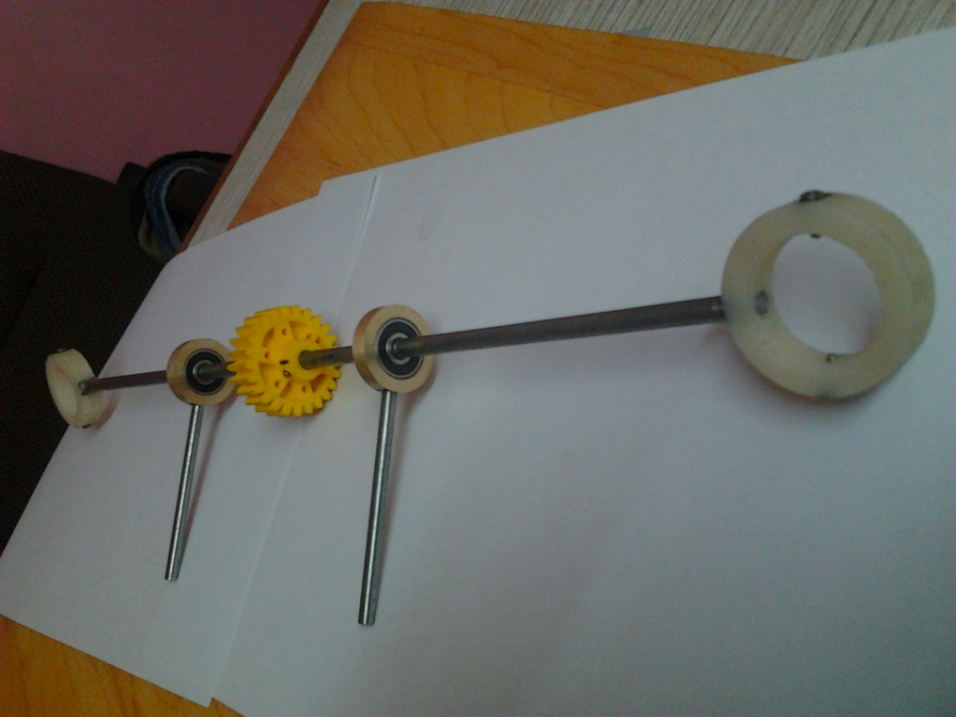
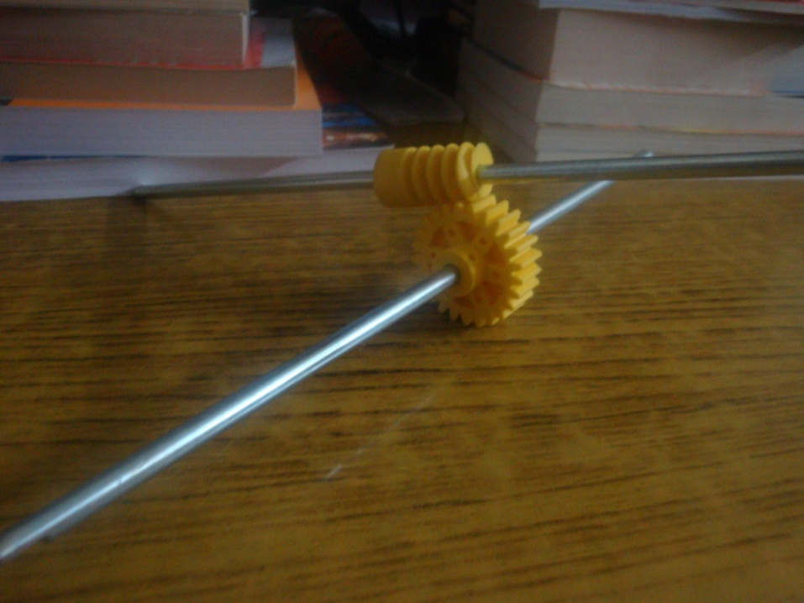
In this design the blimp is controlled entirely through the propellers. By a mechanism called thrust vectoring . In which we turn the propellers to get thrust at multiple direction. Which is more reliable and more simpler.

Slide 6
Advantages
we will be able to achieve a huge power to weight ratio.
Once a huge power to weight ratio is obtained, we will require only a small amount of power to be able to cover long distances. So, lighter the Plane, the greater range it will have.
As a major part of the uplift for the plane is provided by the helium balloon, we can obtain very low flying velocity as there is no worry of stalling.
This is a major advantage when it comes to search and rescue and surveillance missions.
If designed with more accuracy, then the plane will also be able to hover in mid air which will be a boon for surveillance missions.
Another major advantage is the power consumption. As there is no minimum air speed to be maintained, the motor need not be always running and can be switched on and off depending on the requirement.

Slide 7
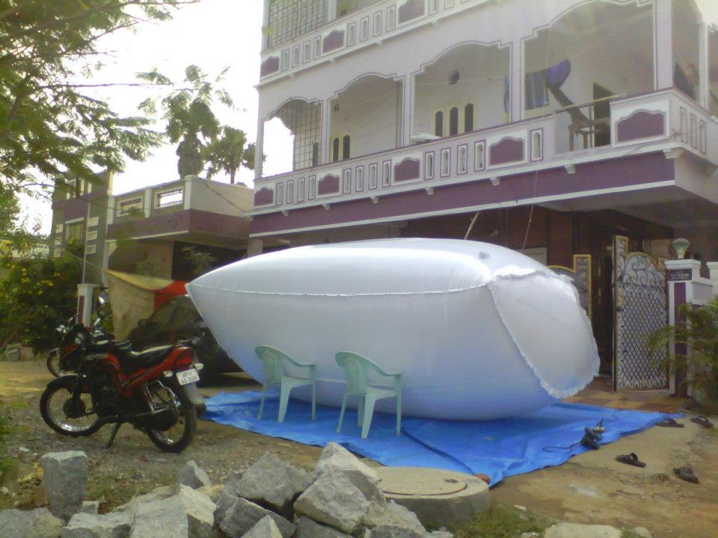
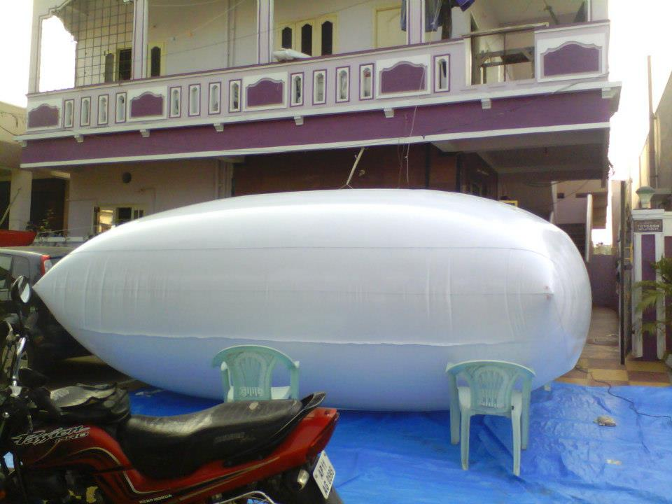
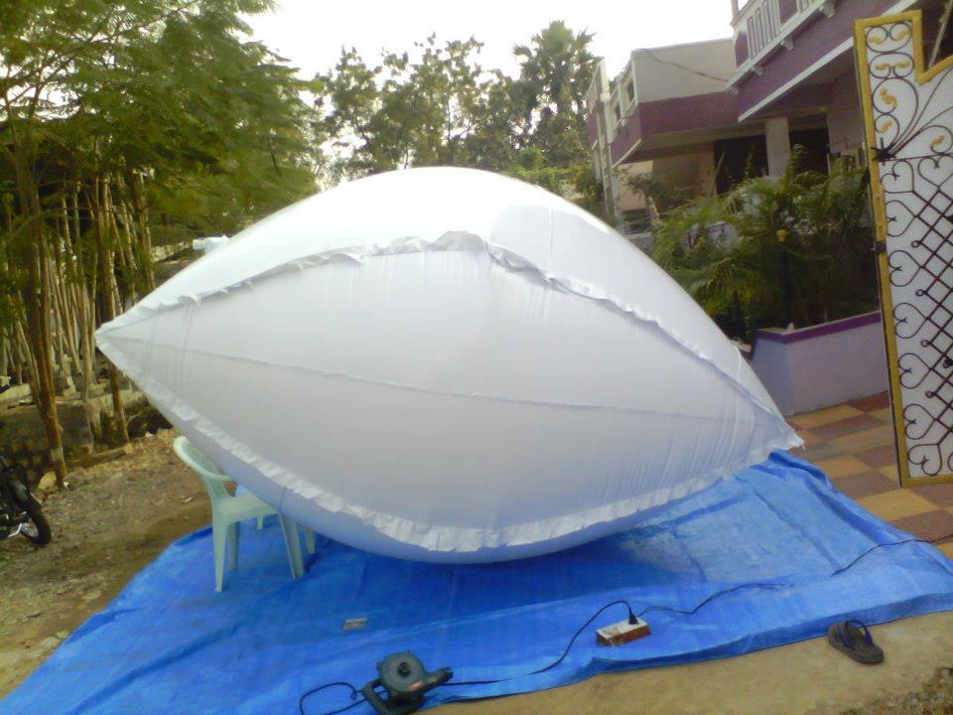
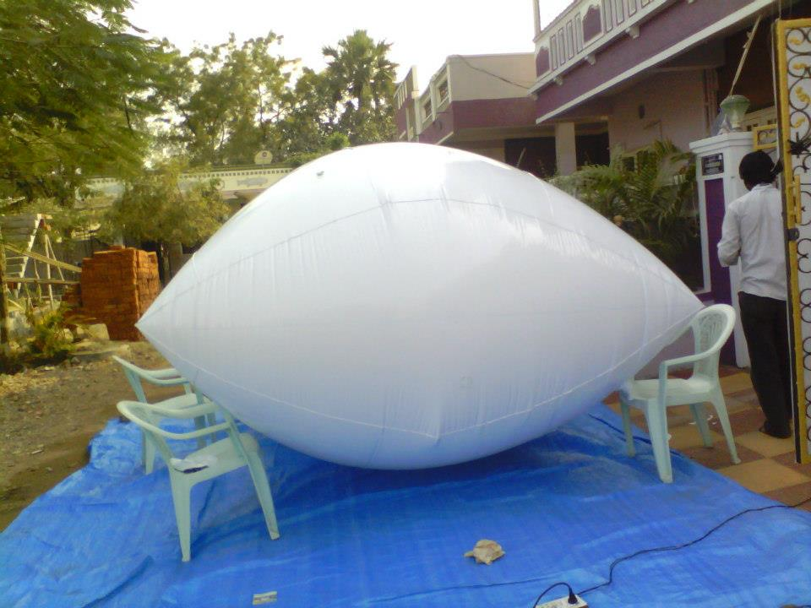

Slide 8
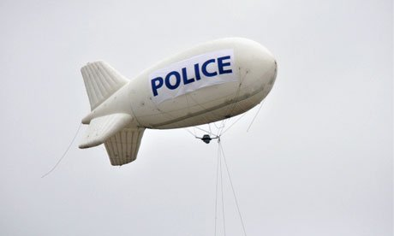
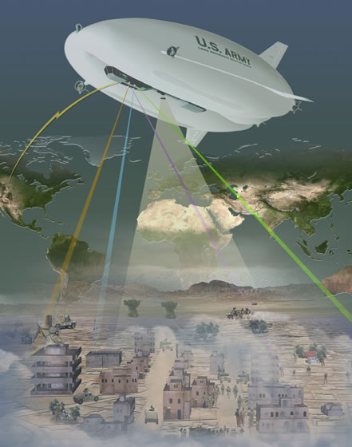
Conclusion
With this innovation, a plane for search and rescue and surveillance mission can be created that has a very large range. If the motors are powered by solar power, then the plane can have an indefinite amount of flight time.

